Slide 1
WELCOME

Slide 2
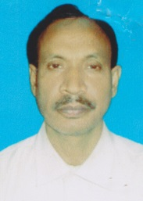
Introducing
Barayet ullah
Asst.Teacher
Pathannagor Aminia Fazil Madrasa,
Subject- English 1st Paper
Class-Nine
Unit-3
Lesson-5

Slide 3
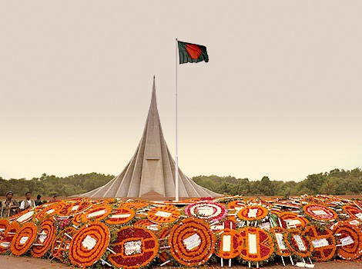
Independence Day

Slide 4
Learning Outcomes
By the end of the lesson ,Learners will be able to-
Develop vocabs-(Festival, Wreath, Illuminate, Parliament, Procession)
Practise the function of Independence Day.
Write a paragraph on Independence Day

Slide 5
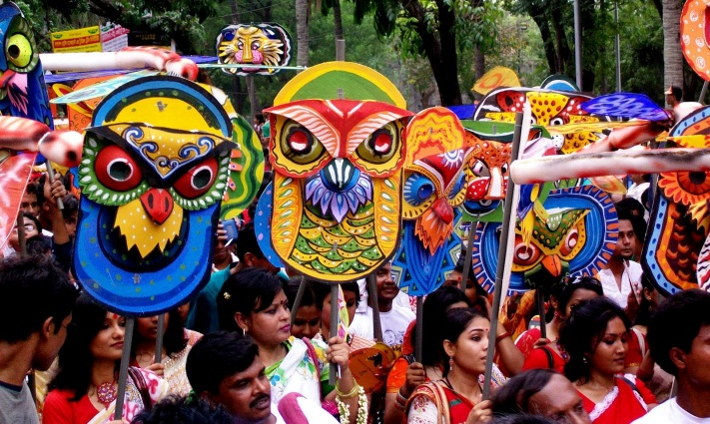
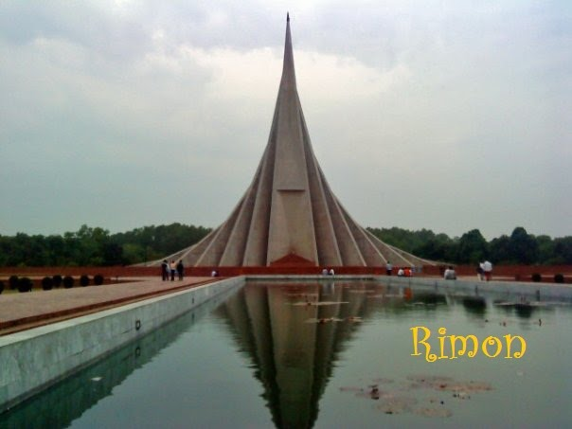
Festival
An occasion for celebration
Mausoleum
Memorial

Slide 6
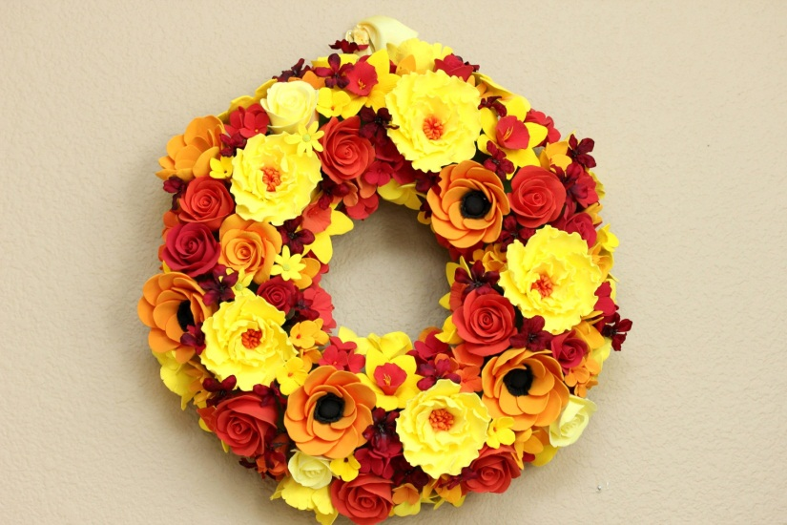
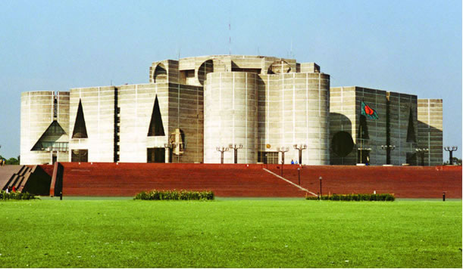
Wreath
A ring or circle of flowers
Parliament
Assembly house

Slide 7
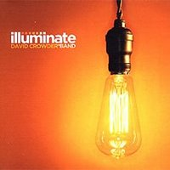
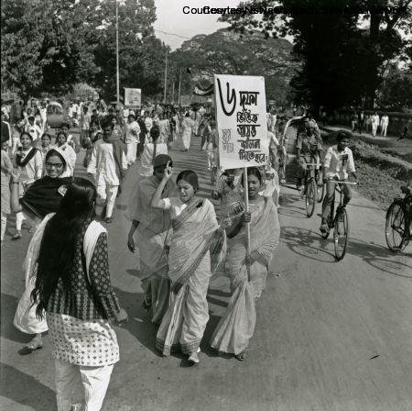
Illuminate
Supply with light
Procession
Rally

Slide 8
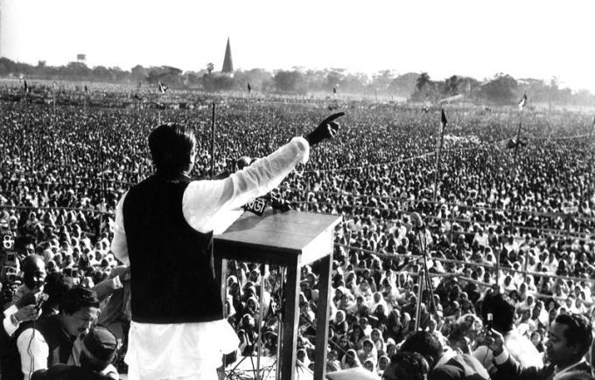
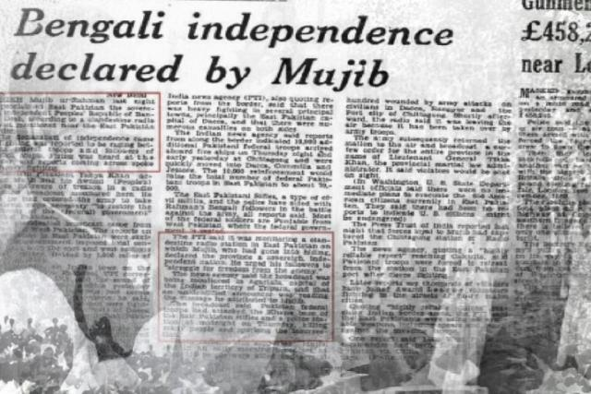
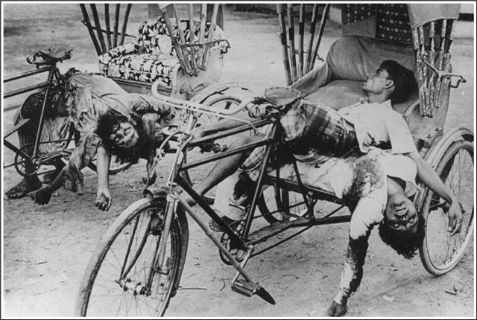
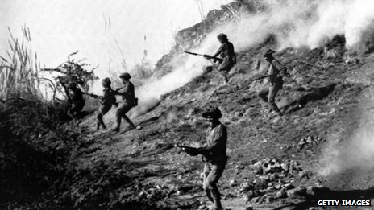
Declaration of Independence
Newspaper Documents
Genocide of Pakistani Army
Invasion of Pakistani Army

Slide 9
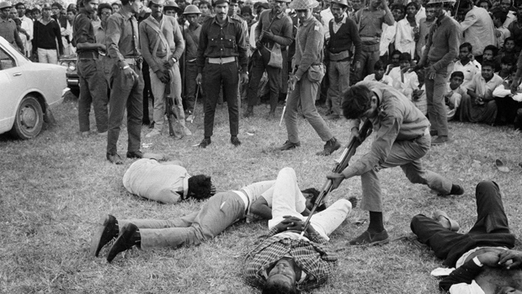
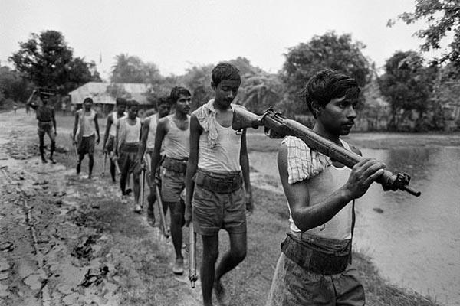
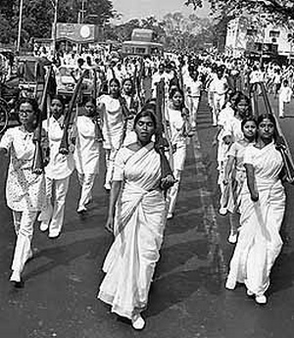
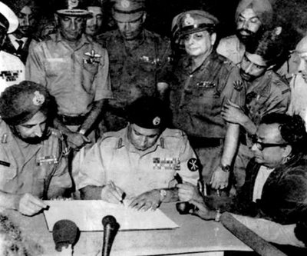
Torture of Pakistani Army
Preparation of Freedom Fighters
Defeat of Pakistani Army
Female Freedom Fighters

Slide 10
The function of Independence Day begins with 31 gunshots

Slide 11
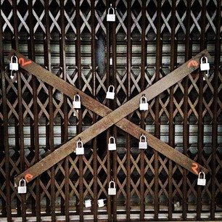
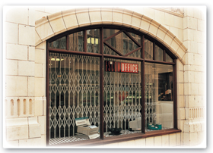
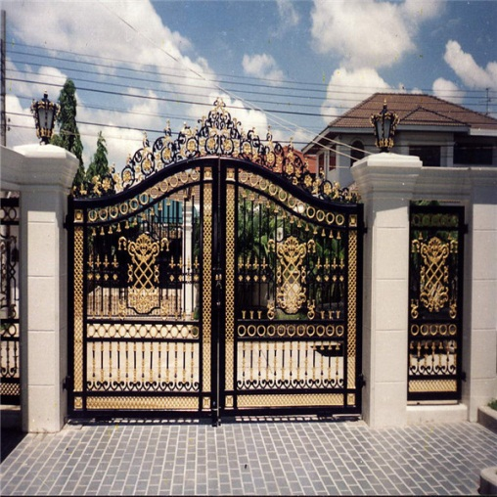
26 March is a national holiday
Shops remain closed
Factories are locked
Offices are closed

Slide 12
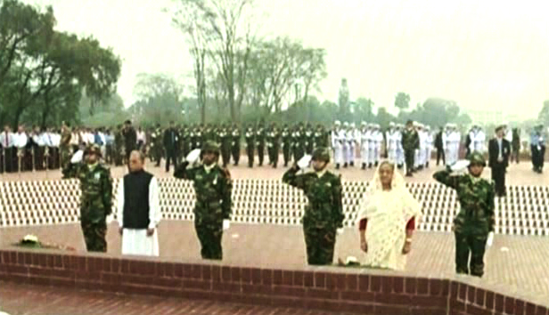
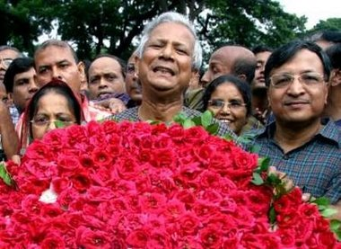
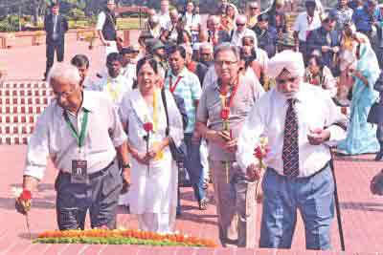
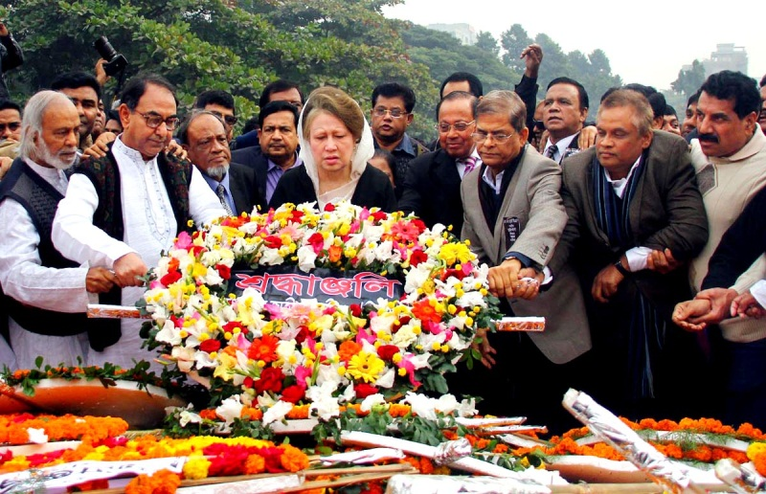
Offering Wreaths at National Mausoleum
Prime Minister &President
Social organisation
Diplomats
Political Parties

Slide 13
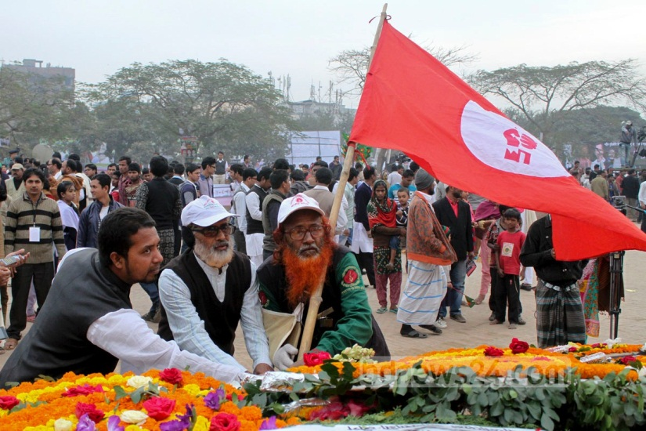
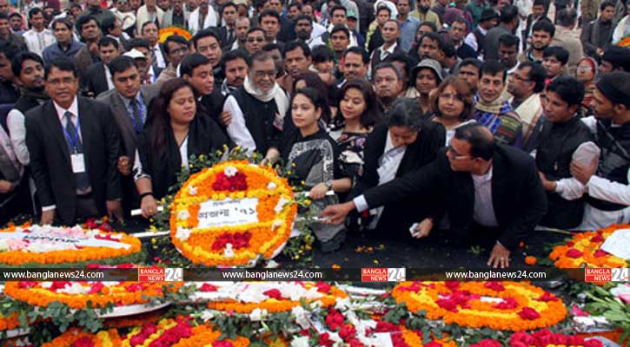
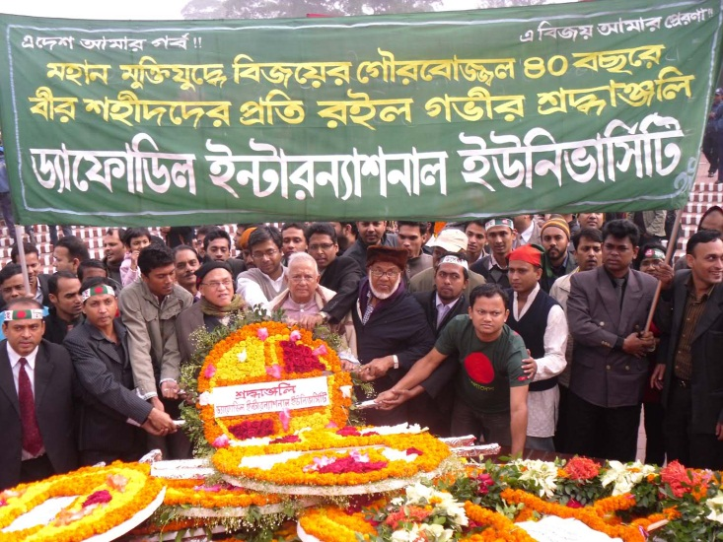
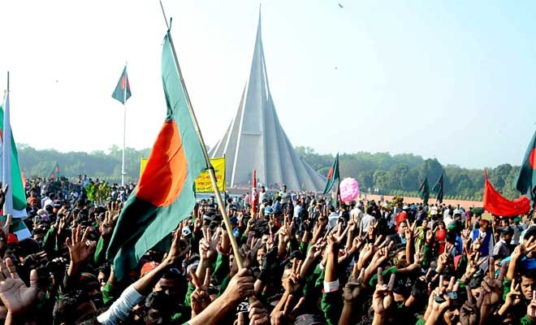
Offering Wreaths at National Mausoleum
Cultural Organization
Freedom Fighters
People from all walk of life
Institution

Slide 14
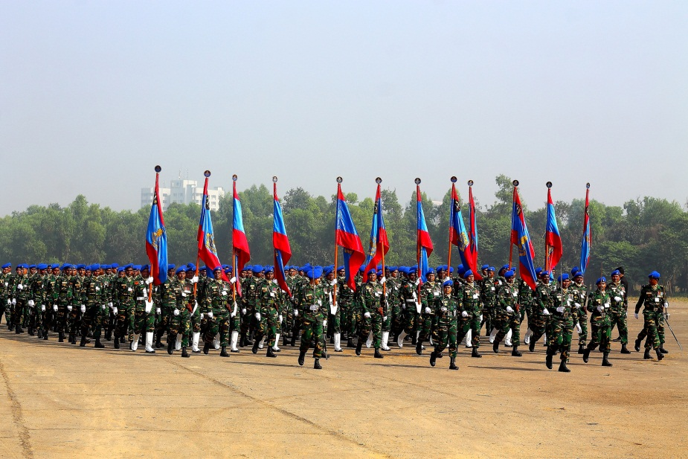
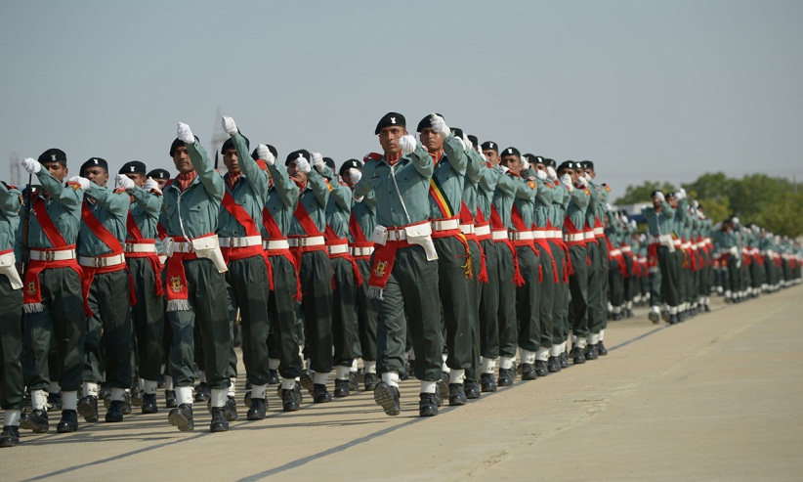
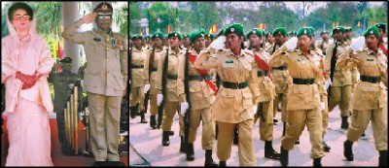
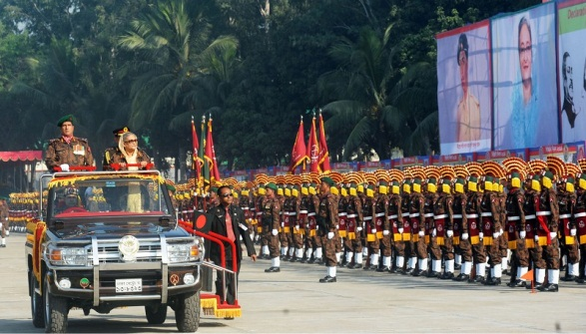
Parade of Defence Forces at National Parade Ground
Army
Police
BGB
Ansars

Slide 15
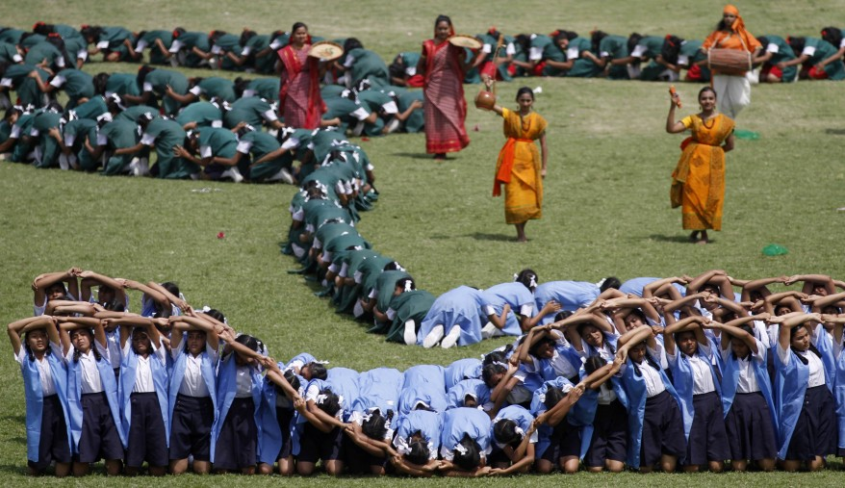
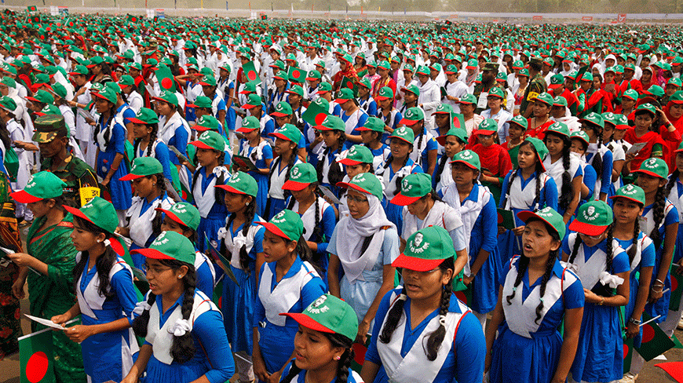
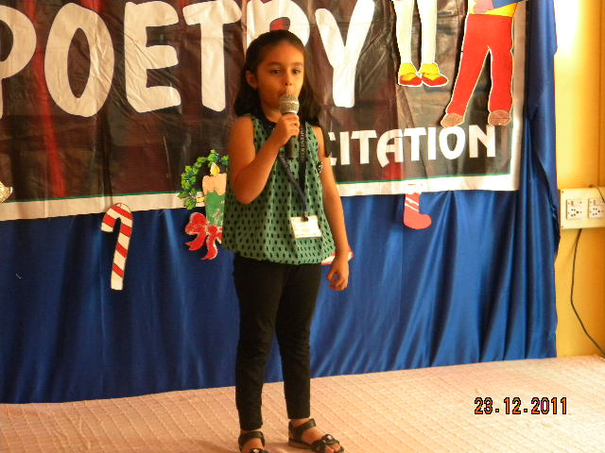
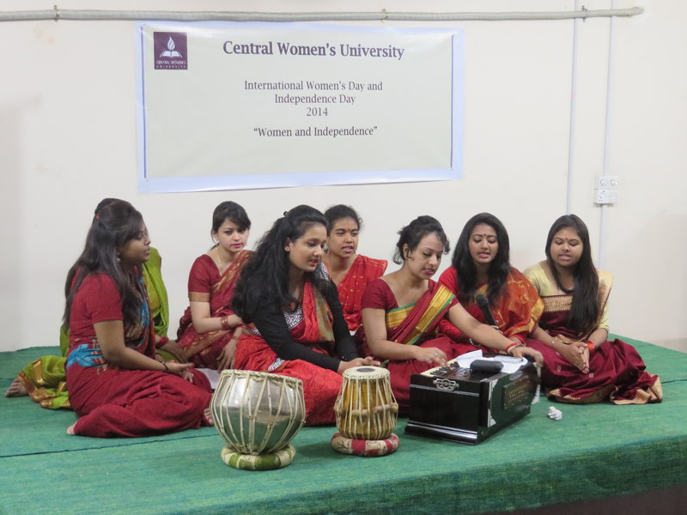
At Educational Institution
Display
Singing National Anthem
Reciting Poems
Musical Ceremony

Slide 16
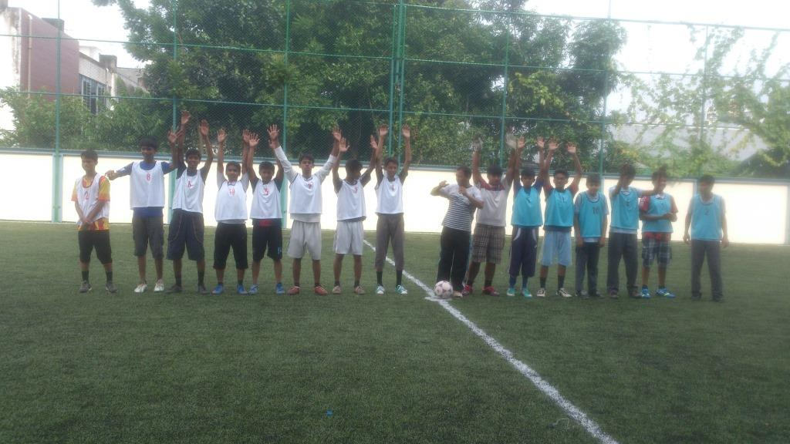
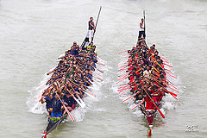
Tournament Held
Boat Race

Slide 17
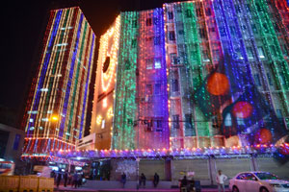
In the Evening
Major Buildings Illuminated with Colourful Lights

Slide 18
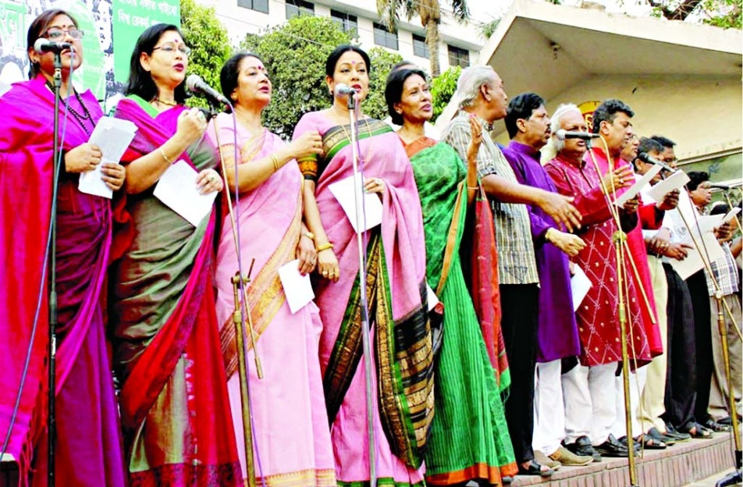
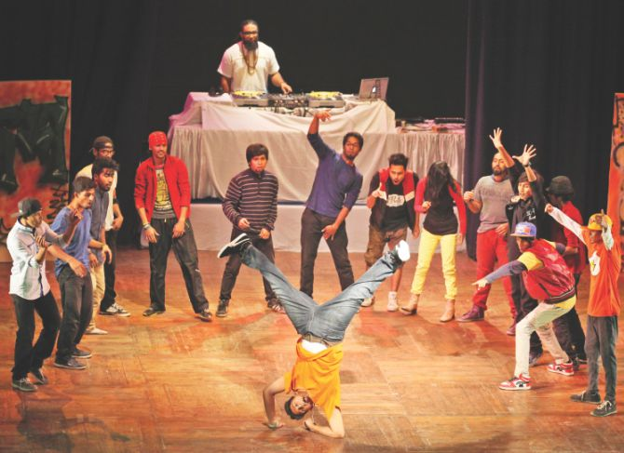
Bangla Academy Hold Musical Ceremony
Shilpakala Academy Arranged Drama

Slide 19
Group Work
Write the name of the ten functions of the Independence Day.

Slide 20
Evaluation
(1)Who parade in Independence Day?
(2)Which organisations offer wreaths at the National Mausoleum?

Slide 21
Home Work
Write, in brief, how you will celebrate this year’s Independence Day at your school

Slide 22
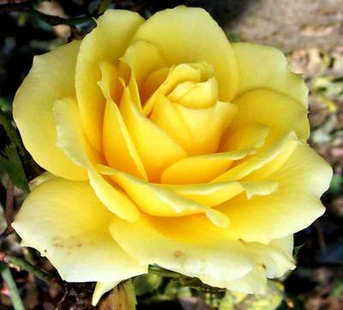
Thanks All

